Slide 1


ACI Limited
Name : Hasibul Hasan
Batch : 14
SL No : 22
Date : 06/06/2024

Slide 2

AGENDA
ACI in Brief
In 1992 ICI divested its investment in Bangladesh to the Management, when its name was changed to Advanced Chemical Industries (ACI) Limited.
ACI Limited, being one of the largest conglomerates in Bangladesh with a multinational heritage operates across the country through its four diversified strategic business units.

Slide 3
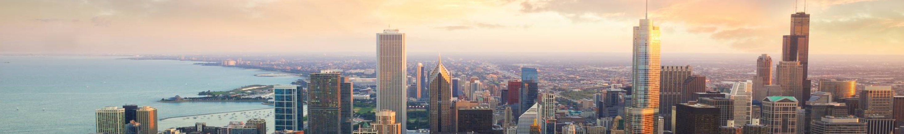
Full Name | Advanced Chemical Industries Limited
Incorporation Date | 24 January 1973
Registration No | C-3885
Company Type | Public Limited
Number of employees | 11,077
Authorized capital | 1,500,000,000
Issued and paid capital | 762,056,260
No of Shares | 76,205,626
Face Value | 10
Year End | 30 June

Slide 4


Product and Services
ACI COMPANY
LIMITED
FOOD
ITEMS
MEDICAL
KITS
COSMETICS
PRODUCT

Slide 5

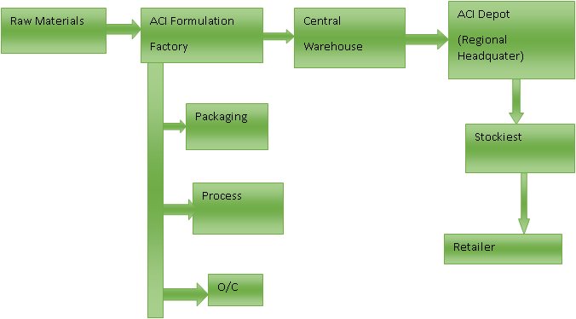
Business Flow Chart

Slide 6
Sales and Cost Statistics
Yearly Report
Month | Expenses | Sales | Profit
January | 9288500 | 8750000 | -538500
February | 9744300 | 9920000 | 175700
March | 8904700 | 10000000 | 1095300
April | 7345200 | 7957400 | 612200
May | 8987000 | 9876500 | 889500
June | 5215400 | 5164500 | -50900
July | 9976500 | 11543600 | 1567100
August | 7976700 | 8087900 | 111200
September | 9879000 | 9969800 | 90800
October | 6234800 | 7024300 | 789500
November | 4534800 | 4809300 | 274500
December | 834870 | 8834800 | 7999930

Slide 7
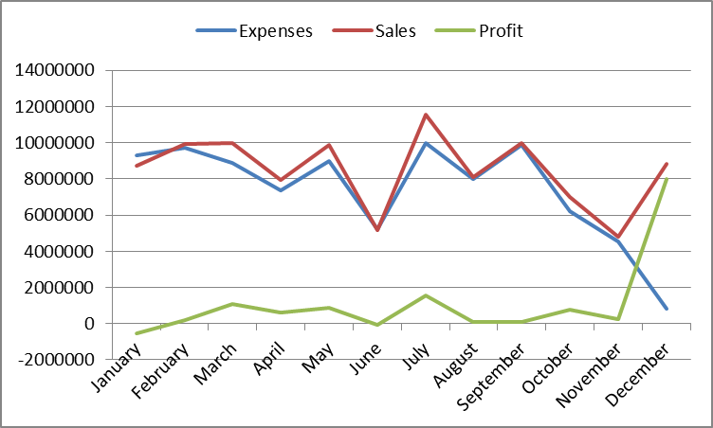
Sales and Cost Statistics

Slide 8

Conclusion
ACI's mission is to achieve business excellence through quality by understanding, accepting, meeting and exceeding customer expectations.
ACI follows International Standards on Quality Management System to ensure consistent quality of products and services to achieve customer satisfaction.
ACI also meets all national regulatory requirements relating to its current businesses and ensures that current Good Manufacturing Practices (cGMP) as recommended by World Health Organization is followed properly.

Slide 9
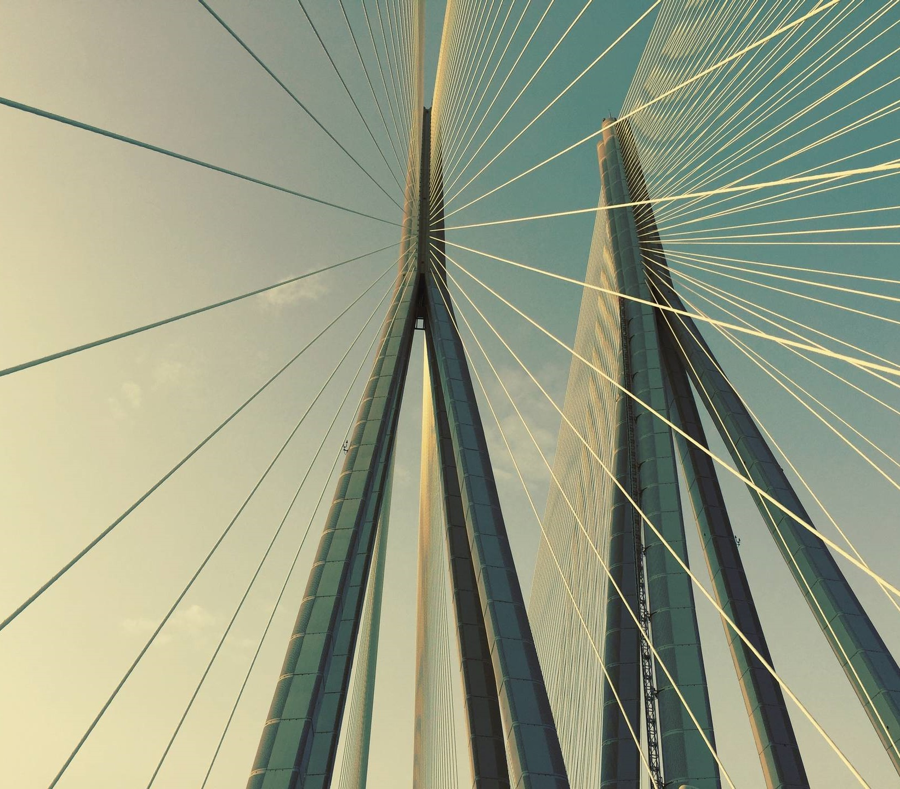

THANK YOU
HEAD OFFICE:
ACI Centre 245, Tejgaon Industrial Area, Dhaka-1208, Bangladesh.
SHARE DIVISION:
9 Motijheel C/A, Dhaka-1000, Bangladesh.

